Slide 1
Work Education
What is it?
Why is it important?

Slide 2

Work & Life Education 2026
Work & Life Education has replaced both Connect and Pathways. The work education program will cover many things in relation to Careers:
Work Experience
OH&S (occupational health & safety)
Resumes/employer cover letters
Part time employment
Career Quizes
Guest Speakers
Tertiary Information
Preparing for Work……..and much more

Slide 3
Work experience
Compulsory for Year 10 students, therefore no classes that week
Monday 22nd June – Friday 26th June (last week of Term 2)
Students to source their placement by Period 5, Monday 30th March (work Experience forms due to Ms TSA)
CONNECTIONS ARE EVERYTHING! Start with family and friends
Must complete paperwork (signed work experience form) and give to Ms Tsaveas or your Work Ed teacher
Additional forms can be found under your Work Ed resource tab on Compass
Show Reuben’s email as example & yellow pages searching

Slide 4

Where to start with finding a placement:
Firstly, consider businesses and organisations that interest you most – research them, visit them, talk to someone who works there.
Secondly, ask your family members and family friends, as well as coaches and adults external to KHS.
Third option, if you struggle to find a placement, we have parents and alumni (former students) connections who might be able to help you. See Ms Elise Dunstan (CR3) if this is the case.
Make sure you consider the location of the placement and ensure you can get there.

Slide 5

Applying for work experience with personal connections
Is your resume up to date?
If your resume is ready to go, attach it to an email or better still, hand deliver to the Manager / Owner of the business and introduce yourself. MAKE A POSITIVE FIRST IMPRESSION!
Consider using the following template…

Slide 6
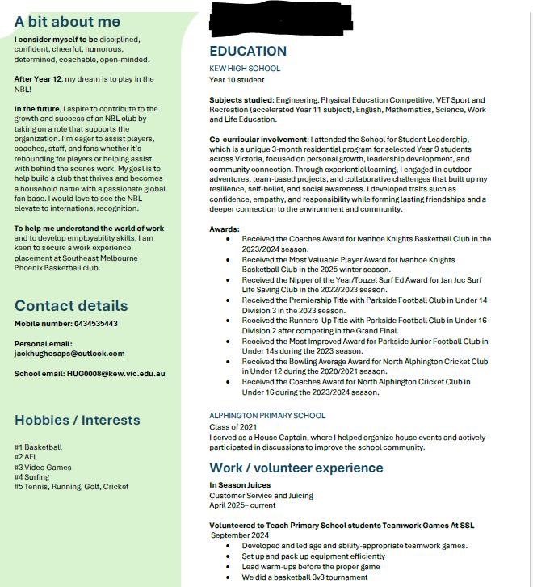
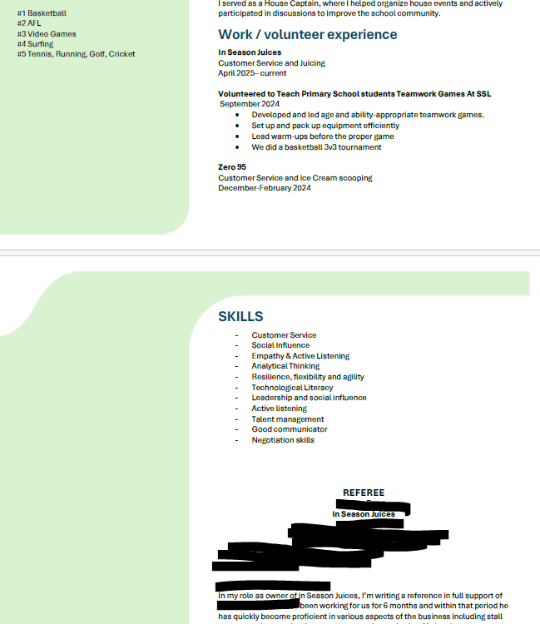

Slide 7
Subject: Kew High School work experience inquiry
Dear Michael,
My name is Reuben Lueth, and I am a Year 10 student at Kew High School. I attended the session you presented at the school last year. As a result of your presentation, I am now involved in discussions focussing on how we can implement some of the concepts you discussed into the school grounds.
In Year 10, all students undertake a work experience placement in the last week of Term 2, Monday 22nd June – Friday 26th June.
I have a strong interest in environmental design and architecture and am keen to learn more about your field of work. Would you consider offering your expertise and time to having me work alongside you and your team?
Kind regards,
Reuben Lueth
Year 10
Kew High School

Slide 8
Overview of Work Ed sessions for Semester 1
Year 10 Work Education Timeline
PS = Peer support- 24 Yr 10 students are involved and missing from your class
Timeline 2026
Term 1
 | Monday | Period 5
Wk1 | 26th January | No classes
Wk2 PS | 2nd February | Session 1 Intro: Multiple Intelligences Quiz & Career Personality Quiz
Wk3 PS | 9th February | Session 2 -Work Experience assembly (LIB) – How to apply? Followed by Career Action Plan (CAP)
Wk4 | 16th February | Session 3 What is work? Tweak Resume/Cover letter
Wk5 | 23rd February | Session 4 – IBM Presentation- facilitated
Wk6 | 2nd March | Session 5 – Achieving success & Applying for Jobs
Wk7 | 9th March | Labour Day No School
Wk8 PS | 16th March | Session 6 –Elephant program presentation - facilitated
Wk9 | 23rd March | Session 7- OH&S Intro
Wk10 | 30th March | Session 8 – OH&S General module ***WORK EXPERIENCE FORMS DUE
Term 2
Wk1 | 20th April | Session 9 – OH&S Industry module
Wk2 | 27th April | Session 10 – OH&S Catch Up session – UPLOAD both modules to Learning task/Compass Insights
Wk3 | 4th May | Session 11 –/ Start Career Profile Investigation task
Wk4 | 11th May | Session 12 - Careers Week : alumni assembly
Wk5 | 18th May | Session 13 - Career Profile Investigation task
Wk6 | 25th May | Session 14 – Career Profile Investigation/ Course search/Tertiary Investigation
Wk7 | 1st June | Year 10 Exams – No classes
Wk8 | 8th June | Kings Birthday – No School
Wk9 | 15th June | Session 15 – Prerequisites/Subject selection prep/Work experience booklets distributed
Wk10 | 22nd June | WORK EXPERIENCE

Slide 9
TASK | OUTLINE | DATE
CAREER ACTION PLAN | Learning task 1 | 16th February
WORK EXPERIECE form | Organised and Signed (both Employer and student /parent) and submitted | 30th March
WORK EXPERIENCE DATES | All students will be participating in Work Experience – NO CLASSES | 22nd to the 26th of June
GENERAL MODULE (OH&S) | Learning task 2A Complete and Upload | 30th March
INDUSTRY MODULE (OH&S) | Learning Task 2B Complete and Upload | 27th April

Slide 10
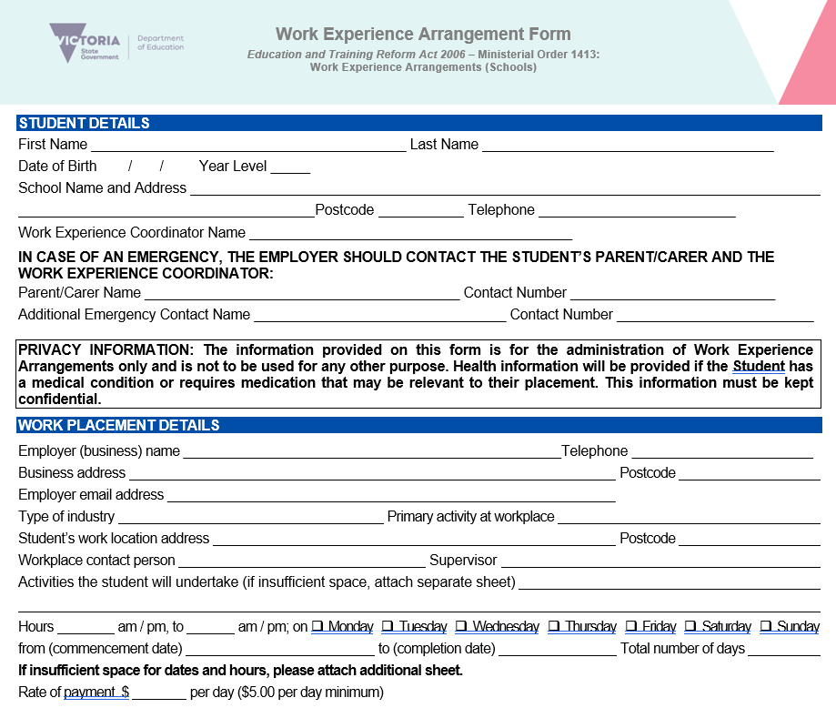

Slide 11
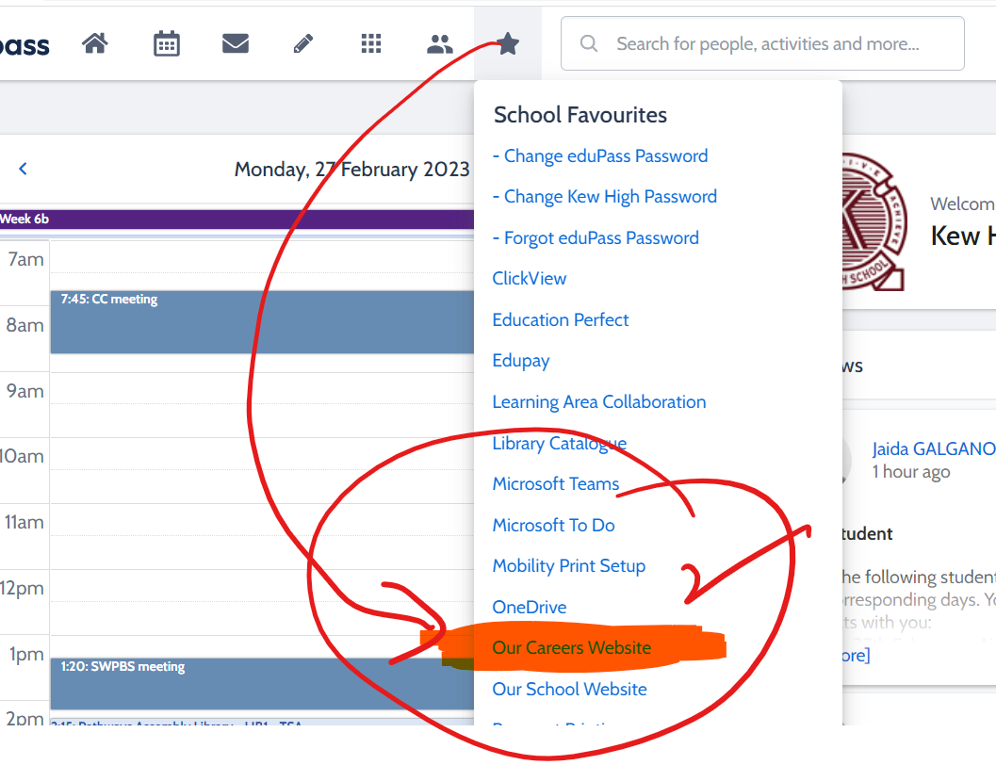

Career Tools
https://www.kewhighschoolcareers.com.au/

Slide 12
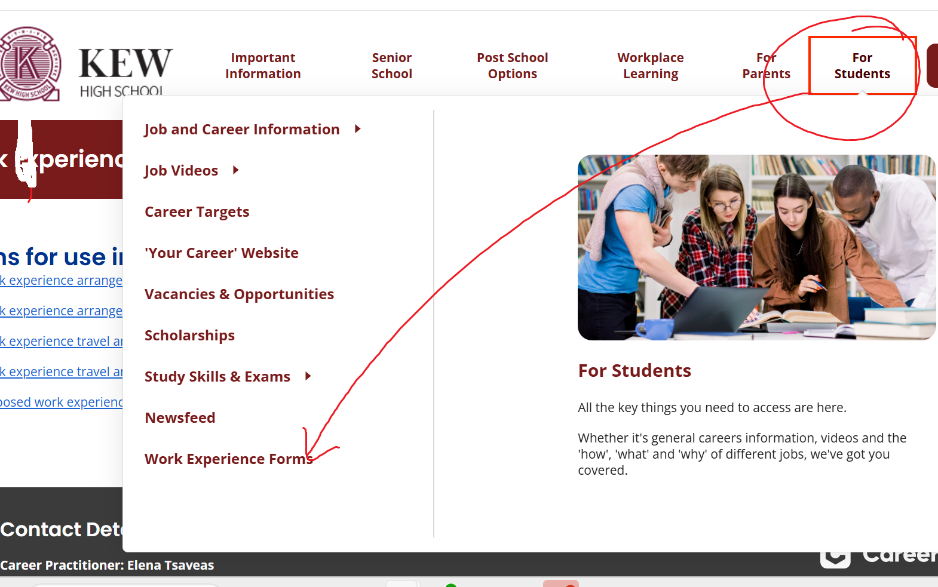
Easy place to find Work Experience Forms (either school career website or Work Ed teams)

Slide 13
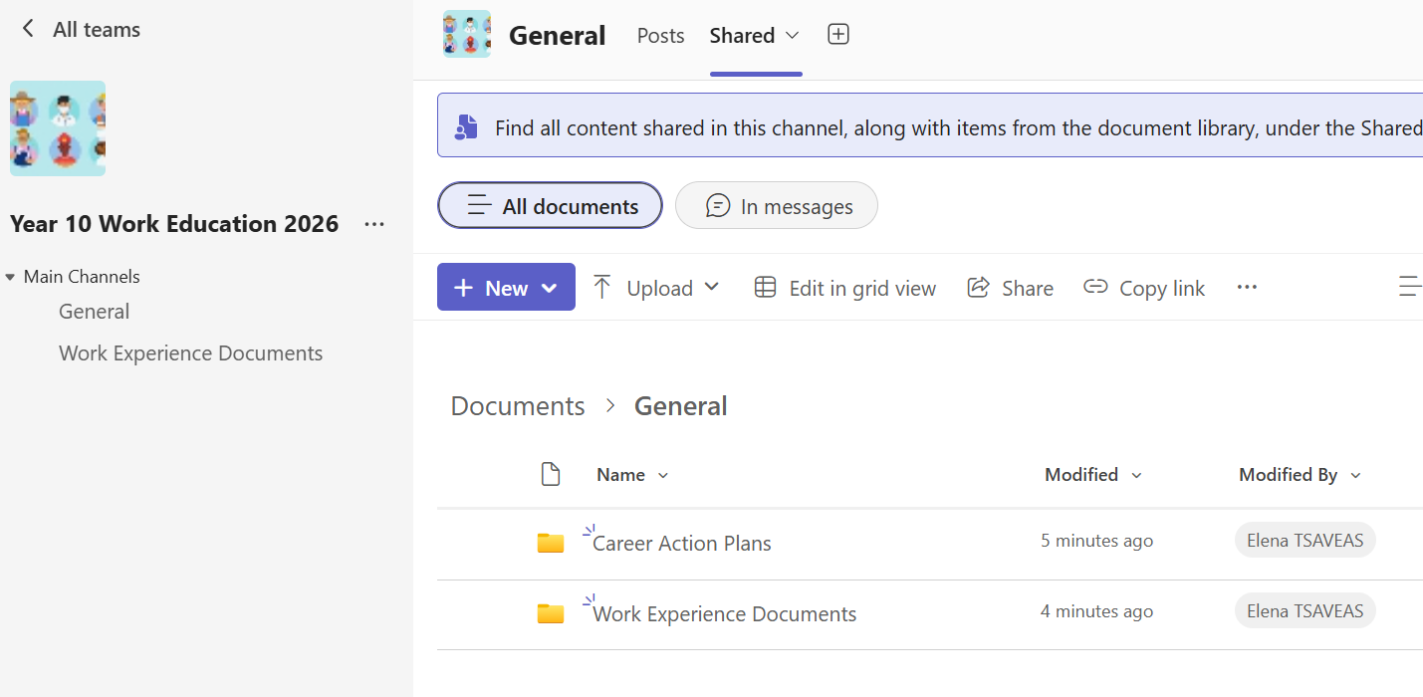
All documents also on Teams (Year 10 work education 2026)

Slide 14
Forms for use in work experience arrangements
Work experience arrangement form (DOCX)
Work experience arrangement form (PDF)
Work experience travel and accommodation form (DOCX) (to be used where relevant)
Work experience travel and accommodation form (PDF) (to be used where relevant)
Proposed work experience with animals – summary of student's experience (DOCX)

Slide 15
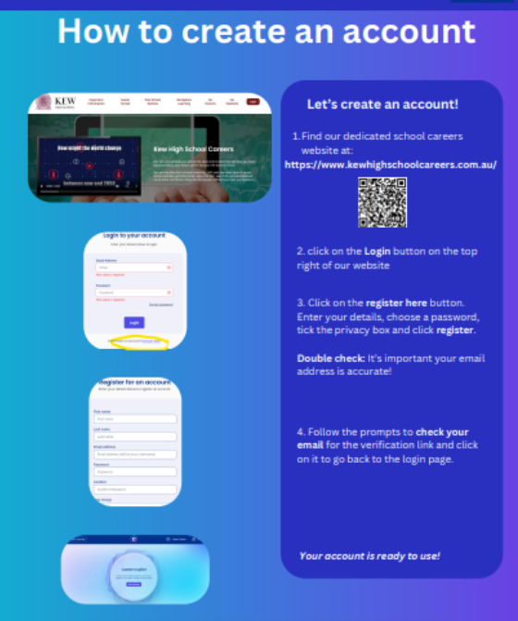
For students absent last week Now create / update / log into your profile – link: Career Tools how to create an account.pdf
Resetting the password:
1. Go to the Log in page (via your school's Career Website) 2. Click the "Forgot Password" link 3. The student will input their email address and click "Send password reset email"

